Slide 1
TURF MANAGEMENT
SAYUJ A.P
Reg No: MES20MCA-2046
Product Owner: Ms. Febin Aziz

Slide 2
TABLE OF CONTENTS
Introduction
Modules
Methodology
Developing Environment
Future Enhancements
Product Backlog
User Stories
Project Plan
Sprint Plans
Sprint Actual

Slide 3
INTRODUCTION
The project Turf management is helpful to get to manage the activity of turf. Admin is the main user of the website who will manage every activity. This application can be used by the Football enthusiastic players to book the available turf according to their need.
This application not only helps the players but also the turf owners who want to expand their business through online medium. It maintain the List of Turf and Booking History so it will be easy to access any time 24*7.
This system has replaced the manual process of going to the location to book with an automated online process. Through, this application admin who is one of the users of this application will manage all the activities of Users such as search user, Add Turf, Manage Turf, and View Bookings.

Slide 4
MODULES
ADMIN
Login
Register and manage Turf locations
Register and Manage Turf managers
View feedback
View complaints and post reply
MANAGER
Login
Register time slot with fees
View booking and manage
View payment

Slide 5
MODULES
USER
Register
Login
View turf locations
Book turf
View booking status
Add payment
Post feedback
Post complaint and view reply

Slide 6
Methodology
Turf playground are used to play various sports like football, rugby, tennis, cricket, etc. People enjoy playing on the turf, it has vibrant environment and very safe to play. Many school teams and clubs prefer turf playground for practice and training purpose. Sometime it becomes difficult to book turf playground because of timing issue or the slot getting booked previously. This sports ground booking website is proposed for booking the turf in an easy and efficient way. It has three modules namely, Admin, Manager and User. Admin can login and can add turf locations, assign manager by creating login credentials for manager, add price details for the particular turf, manages turf and view the details of sports venues booking for all locations. Managers assigned by the Admin are different for different Turf playground locations. User can login to the system by registering details, he/she can login using credentials, he/she can check the rates, view the request for turf booking for the respective location,and manager can accept booking, generate bill and can view the booking history. Users can check the availability of the turf, select timings, fill personal details, can pay by providing bank details or card details and he/she can also see view previous turf booking history.

Slide 7
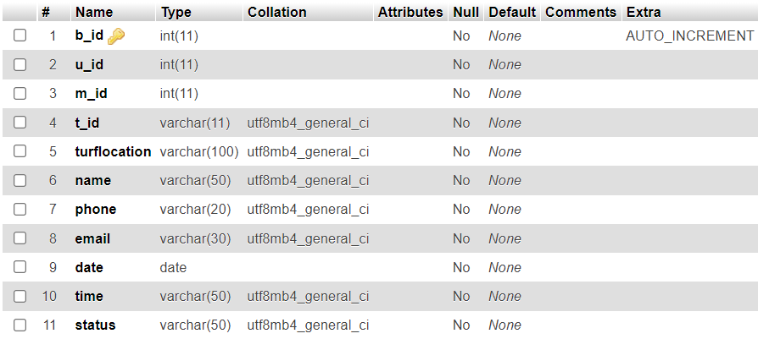
Tables
Booking

Slide 8
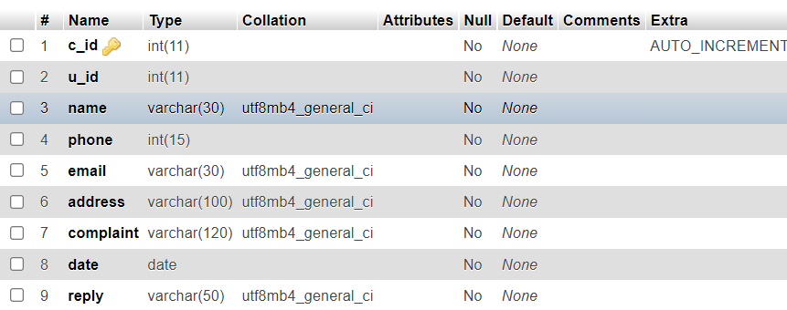
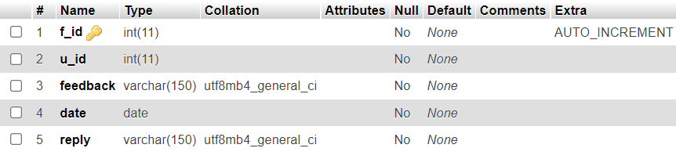
Complaint
Feedback

Slide 9
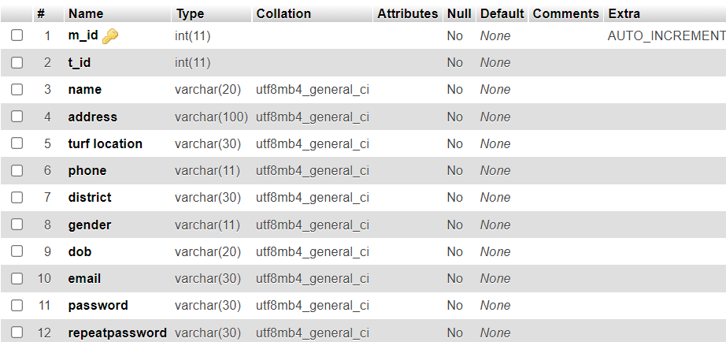
Manager Registration

Slide 10
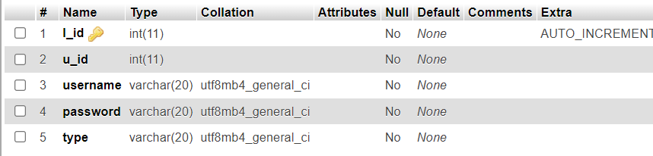
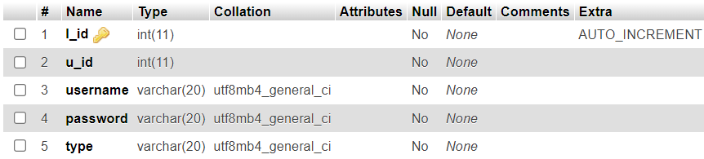
Login
Turf Location

Slide 11
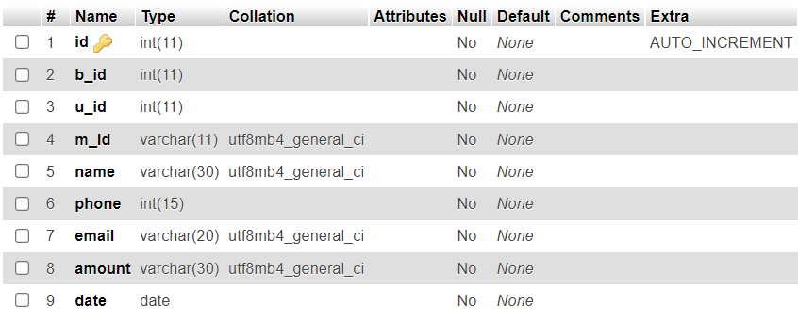
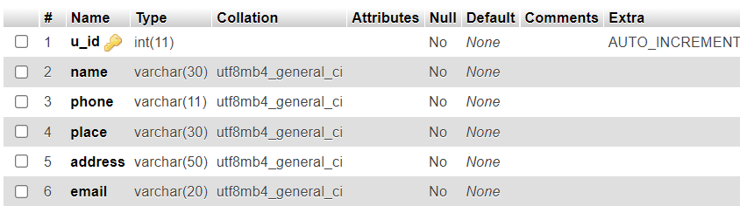
Payment
User

Slide 12
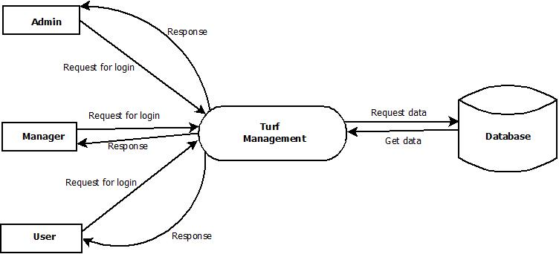
Data Flow Diagram
Level - 0

Slide 13
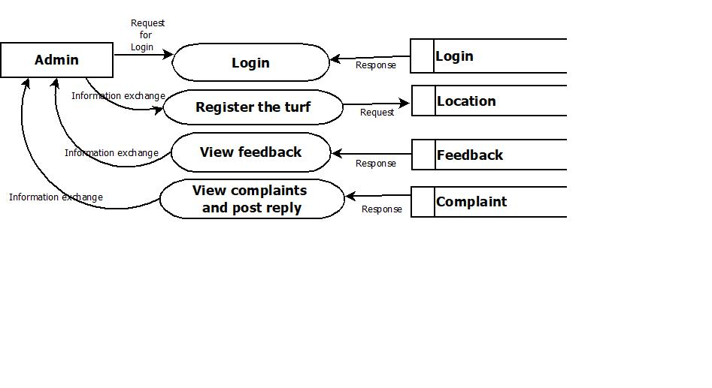
Level – 1 : Admin

Slide 14
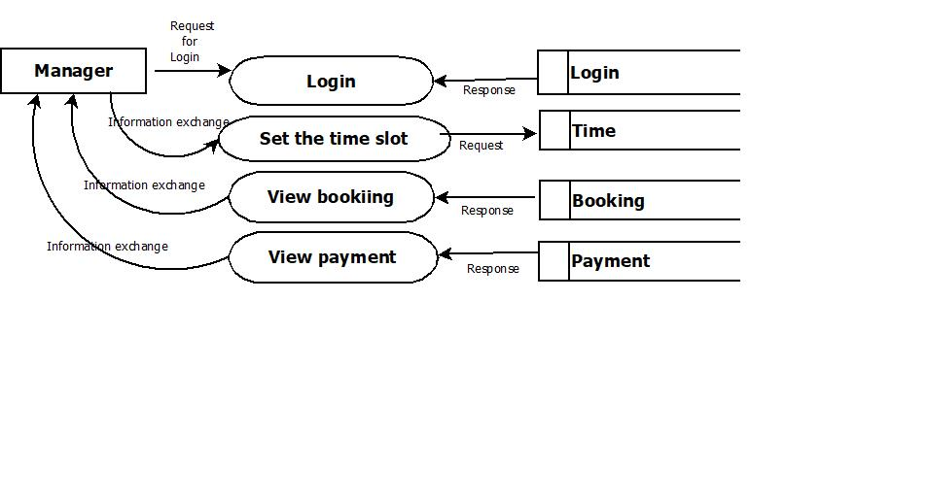
Level – 2 : Manager

Slide 15
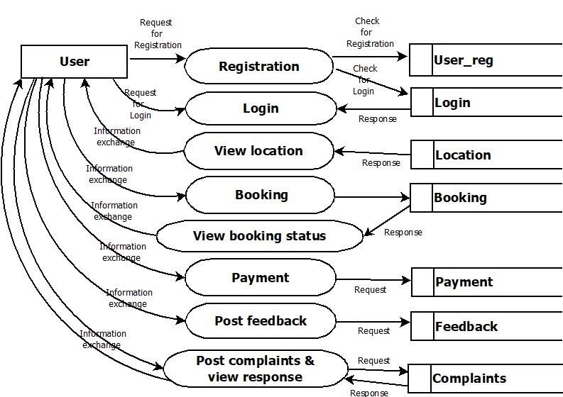
Level – 3 : User

Slide 16
DEVELOPING ENVIRONMENT
Language: Python
Front End: Html, CSS, Java script
Back end: Python-django
Database : MySQL
IDE: PyCharm
OS: Windows/Linux

Slide 17
Future Enhancements
We can add live updates of of world football.
We can add other sports activities booking to the project.

Slide 18
PRODUCT BACKLOG
User story ID | Priority <High/Medium/Low> | Size (Hours) | Sprint <#> | Status <Planned/In progress/Completed> | Release Date | Release Goal
1 | Medium | 3 | 1 | Completed | 27-11-2021 | Home page of admin
2 | High | 4 |  | Completed | 05-12-2021 | Add turf details
3 | Medium | 3 | 2 | Completed | 08-12-2021 | Home page of manager
4 | High | 4 |  | Completed | 15-12-2021 | Manager set the time slot
5 | Medium | 2 |  | Completed | 22-12-2021 | User registration
6 | Medium | 3 |  | Completed | 24-12-2021 | Login to the system
7 | Medium | 2 |  | Completed | 01-01-2022 | View the turf details
8 | Medium | 3 | 3 | Completed | 05-01-2022 | Book the turf
9 | Medium | 2 |  | Completed | 08-02-2022 | View booking details
10 | High | 4 |  | Completed | 12-02-2022 | Status updates

Slide 19
User story ID | Priority <High/Medium/Low> | Size (Hours) | Sprint <#> | Status <Planned/In progress/Completed> | Release Date | Release Goal
11 | Medium | 3 | 3 | Completed | 17-01-2022 | View booking details
12 | High | 4 |  | Completed | 19-01-2022 | Make payments
13 | Medium | 2 |  | Completed | 26-01-2022 | View the payment details
14 | Medium | 3 |  | Completed | 31-01-2022 | Post feedback
15 | Medium | 3 |  | Completed | 02-02-2022 | View feedback
16 | Medium | 3 | 4 | Completed | 12-02-2022 | Post complaints and view response
17 | Medium | 2 |  | Completed | 16-02-2022 | View complaints and send response

Slide 20
USER STORY
User story ID | As a <type of user> | I want to <perform some task> | So that I can <achieve some goal>
1 | Admin | Access home page and login | Home page of admin access the system
2 | Admin | Registering the turf | Admin can register the available turf
3 | Manager | Access home page and login | Home page of manager access the turf details
4 | Manager | Setting the time slot | Manager can set the time for playing
5 | User | Registration | Register to the system and create profile
6 | User | Login and access home page | Access the system
7 | User | View the turf details | View turf is available or not
8 | User | Book the turf | Book the turf
9 | Manager | View bookings | View the booking details
10 | Manager | Status updates | Send the details to users

Slide 21
User story ID | As a <type of user> | I want to <perform some task> | So that I can <achieve some goal>
11 | User | View booking | View booking details
12 | User | Make payment | Pay the amount
13 | Manager | View payment details | View the payment details
14 | User | Post feedback | Post feedback
15 | Admin | View feedback | View feedback
16 | User | Post complaints | Post complaints and view feedback
17 | Admin | View complaints | View complaints and post response

Slide 22
PROJECT PLAN
User Story ID | Task Name | Start Date | End Date | Days | Status
1 | Sprint 1 | 23-11-2021 | 27-11-2021 | 10 | Completed
2 |  | 29-11-2021 | 05-12-2021 |  | Completed
3 | Sprint 2 | 06-12-2021 | 08-12-2021 | 12 | Completed
4 |  | 13-12-2021 | 15-12-2021 |  | Completed
5 |  | 20-12-2021 | 22-12-2021 |  | Completed
6 |  | 22-12-2021 | 24-12-2021 |  | Completed
7 |  | 27-12-2021 | 01-01-2022 |  | Completed
8 | Sprint 3 | 03-01-2022 | 05-01-2022 | 14 | Completed
9 |  | 05-01-2022 | 08-02-2022 |  | Completed
10 |  | 10-01-2022 | 12-02-2022 |  | Completed

Slide 23
User Story ID | Task Name | Start Date | End Date | Days | Status
11 | Sprint 3 | 17-01-2022 | 17-01-2022 | 14 | Completed
12 |  | 19-01-2022 | 19-01-2022 |  | Completed
13 |  | 24-01-2022 | 26-01-2022 |  | Completed
14 |  | 31-01-2022 | 31-01-2022 |  | Completed
15 |  | 02-02-2022 | 02-02-2022 |  | Completed
16 | Sprint 4 | 07-02-2022 | 12-02-2022 | 7 | Completed
17 |  | 14-02-2022 | 16-02-2022 |  | Completed

Slide 24
SPRINT BACKLOG ACTUAL
Backlog Item | Status and Completion date | Original Estimate in hours | Day 1 | Day 2 | Day 3 | Day 4 | Day 5 | Day 6 | Day 7 | Day 8 | Day 9 | Day 10 | Day 11 | Day 12 | Day 13 | Day 14 | Completed <Y/N>
User story #1,2 |  |  | Hours | Hours | Hours | Hours | Hours | Hours | Hours | Hours | Hours | Hours | Hours | Hours | Hours | Hours
UI Designing | 27/11/21 | 2 | 1 | 1 | 0 | 0 | 0 | 0 | 0 | 0 | 0 | 0 | 0 | 0 | 0 | 0 | Y
Database Connectivity | 30/11/21 | 3 | 0 | 0 | 0 | 0 | 2 | 0 | 0 | 1 | 0 | 0 | 0 | 0 | 0 | 0 | Y
Coding | 01/11/21 | 2 | 0 | 0 | 0 | 0 | 1 | 0 | 0 | 0 | 1 | 0 | 0 | 0 | 0 | 0 | Y
Testing | 05/12/21 | 3 | 0 | 0 | 1 | 1 | 1 | 0 | 0 | 0 | 0 | 0 | 0 | 0 | 0 | 0 | Y
User story #3,4,5,6,7
UI Designing | 08/12/21 | 3 | 2 | 1 | 0 | 0 | 0 | 0 | 0 | 0 | 0 | 0 | 0 | 0 | 0 | 0 | Y
Database Connectivity | 15/12/21 | 3 | 0 | 0 | 0 | 1 | 1 | 0 | 1 | 0 | 0 | 0 | 0 | 0 | 0 | 0 | Y
Coding | 24/12/21 | 3 | 0 | 0 | 0 | 1 | 0 | 0 | 0 | 1 | 0 | 0 | 0 | 1 | 0 | 0 | Y
Testing | 01/01/22 | 3 | 0 | 0 | 2 | 0 | 0 | 0 | 0 | 0 | 0 | 0 | 0 | 0 | 0 | 0 | Y

Slide 25
Backlog Item | Status and Completion date | Original Estimate in hours | Day 1 | Day 2 | Day 3 | Day 4 | Day 5 | Day 6 | Day 7 | Day 8 | Day 9 | Day 10 | Day 11 | Day 12 | Day 13 | Day 14 | Completed <Y/N>
User story #8,9,10,11,12,13,14, 15 |  |  | Hours | Hours | Hours | Hours | Hours | Hours | Hours | Hours | Hours | Hours | Hours | Hours | Hours | Hours
UI Designing | 05/01/22 | 4 | 1 | 1 | 1 | 0 | 1 | 0 | 0 | 0 | 0 | 0 | 0 | 0 | 0 | 0 | Y
Database Connectivity | 17/01/22 | 4 | 0 | 0 | 0 | 0 | 0 | 1 | 1 | 0 | 0 | 0 | 0 | 0 | 1 | 1 | Y
Coding | 19/01/22 | 5 | 1 | 0 | 0 | 1 | 0 | 1 | 0 | 0 | 0 | 1 | 0 | 0 | 0 | 1 | Y
Testing | 02/02/22 | 5 | 0 | 0 | 1 | 0 | 0 | 0 | 2 | 2 | 0 | 0 | 0 | 1 | 0 | 0 | Y
User story #16,17
UI Designing | 12/02/22 | 2 | 1 | 0 | 0 | 0 | 1 | 0 | 0 | 0 | 0 | 0 | 0 | 0 | 0 | 0 | Y
Database Connectivity | 13/02/22 | 3 | 1 | 0 | 0 | 1 | 0 | 0 | 1 | 0 | 0 | 0 | 0 | 0 | 0 | 0 | Y
Coding | 15/02/22 | 2 | 0 | 1 | 0 | 1 | 1 | 0 | 0 | 0 | 0 | 0 | 0 | 0 | 0 | 0 | Y
Testing | 16/02/22 | 3 | 0 | 0 | 1 | 0 | 0 | 1 | 1 | 0 | 0 | 0 | 0 | 0 | 0 | 0 | Y
Total |  | 50 | 7 | 4 | 6 | 6 | 8 | 3 | 6 | 4 | 1 | 1 | 0 | 2 | 1 | 2

Slide 26
SPRINT BACKLOG PLAN
Backlog Item | Status and Completion date | Original Estimate in hours | Day 1 | Day 2 | Day 3 | Day 4 | Day 5 | Day 6 | Day 7 | Day 8 | Day 9 | Day 10 | Day 11 | Day 12 | Day 13 | Day 14
User story #1,2 |  |  | Hours | Hours | Hours | Hours | Hours | Hours | Hours | Hours | Hours | Hours | Hours | Hours | Hours | Hours
UI Designing | 27/11/21 | 2 | 1 | 1 | 0 | 0 | 0 | 0 | 0 | 0 | 0 | 0 | 0 | 0 | 0 | 0
Database Connectivity | 30/11/21 | 3 | 0 | 0 | 0 | 0 | 2 | 0 | 0 | 1 | 0 | 0 | 0 | 0 | 0 | 0
Testing | 01/11/21 | 2 | 0 | 0 | 0 | 0 | 1 | 0 | 0 | 0 | 1 | 0 | 0 | 0 | 0 | 0
Coding | 05/12/21 | 3 | 0 | 0 | 1 | 1 | 1 | 0 | 0 | 0 | 0 | 0 | 0 | 0 | 0 | 0
User story #3,4,5,6,7
UI Designing | 08/12/21 | 3 | 2 | 1 | 0 | 0 | 0 | 0 | 0 | 0 | 0 | 0 | 0 | 0 | 0 | 0
Database Connectivity | 15/12/21 | 3 | 0 | 0 | 0 | 1 | 1 | 0 | 1 | 0 | 0 | 0 | 0 | 0 | 0 | 0
Coding | 24/12/21 | 3 | 0 | 0 | 0 | 1 | 0 | 0 | 0 | 1 | 0 | 0 | 0 | 1 | 0 | 0
Testing | 01/01/22 | 3 | 0 | 0 | 2 | 0 | 0 | 0 | 0 | 0 | 0 | 0 | 0 | 0 | 0 | 0

Slide 27
Backlog Item | Status and Completion date | Original Estimate in hours | Day 1 | Day 2 | Day 3 | Day 4 | Day 5 | Day 6 | Day 7 | Day 8 | Day 9 | Day 10 | Day 11 | Day 12 | Day 13 | Day 14
User story #8,9,10,11,12,13,14,15 |  |  | Hours | Hours | Hours | Hours | Hours | Hours | Hours | Hours | Hours | Hours | Hours | Hours | Hours | Hours
UI Designing | 05/01/22 | 4 | 1 | 1 | 1 | 0 | 1 | 0 | 0 | 0 | 0 | 0 | 0 | 0 | 0 | 0
Database Connectivity | 17/01/22 | 4 | 0 | 0 | 0 | 0 | 0 | 1 | 1 | 0 | 0 | 0 | 0 | 0 | 1 | 1
Coding | 19/01/22 | 5 | 1 | 0 | 0 | 1 | 0 | 1 | 0 | 0 | 0 | 1 | 0 | 0 | 0 | 1
Testing | 02/02/22 | 5 | 0 | 0 | 1 | 0 | 0 | 0 | 2 | 2 | 0 | 0 | 0 | 1 | 0 | 0
User story #16,17
UI Designing | 12/02/22 | 2 | 1 | 0 | 0 | 0 | 1 | 0 | 0 | 0 | 0 | 0 | 0 | 0 | 0 | 0
Database Connectivity | 13/02/22 | 3 | 1 | 0 | 0 | 1 | 0 | 0 | 1 | 0 | 0 | 0 | 0 | 0 | 0 | 0
Coding | 15/02/22 | 2 | 0 | 1 | 0 | 1 | 1 | 0 | 0 | 0 | 0 | 0 | 0 | 0 | 0 | 0
Testing | 16/02/22 | 3 | 0 | 0 | 1 | 0 | 0 | 1 | 1 | 0 | 0 | 0 | 0 | 0 | 0 | 0
Total |  | 50 | 7 | 4 | 6 | 6 | 8 | 3 | 6 | 4 | 1 | 1 | 0 | 2 | 1 | 2

Slide 28
THANK YOU

